Slide 1
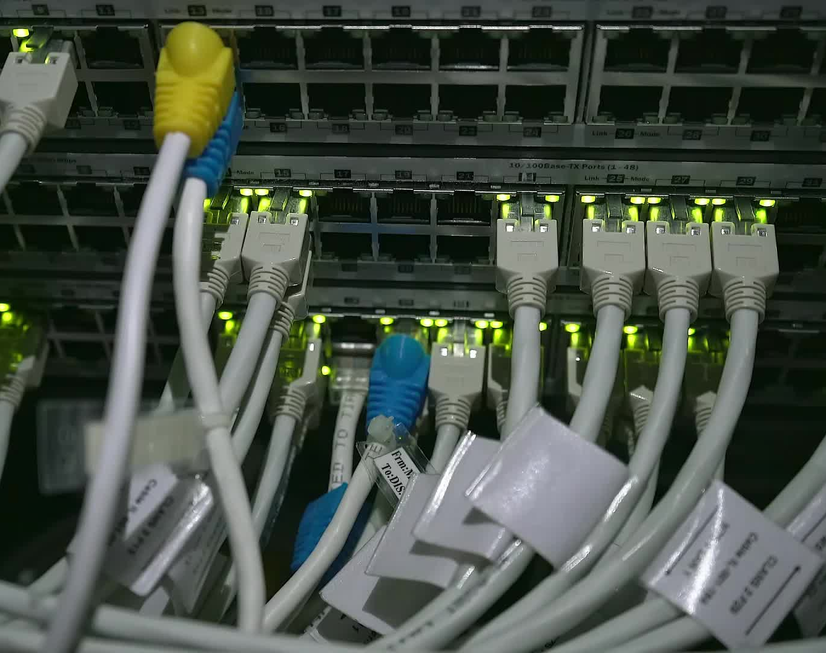
BeamShare
Move files fast on your LAN!

Slide 2

The Problem
Email attachments fail, size restrictions are a headache, cloud uploads are slow, USB drives go missing. Sharing files shouldn’t be this hard.

Slide 3

The Solution
BeamShare lets you share any folder instantly. Others can connect on the same network to download or upload.

Slide 4

Fast & Private
Transfers happen over your own Wi-Fi. No cloud. No waiting. No accounts needed.

Slide 5

Reliability
If Wi-Fi drops, transfers resume. Every file is verified with integrity checks.

Slide 6

Simple Security
Control who joins with one-time access codes. Choose read-only or upload-enabled mode.

Slide 7
Who It’s For
• Students exchanging files • Small teams collaborating • Families sharing photos/videos

Slide 8
For students, home users, and small teams who need a fast, private way to move files, BeamShare is a LAN-first transfer tool that works in seconds.
Vision Statement

Slide 9
Thank You!
BeamShare — Move files fast on your LAN. Thanks for watching!

